Slide 1
Time Series Modelling effects on Pairs Trading Profitability
-among US Sector SPDR ETFs
YUANYUAN LIU
WYATT MARCINIAK
JIMIT SANGHVI
MUYE ZHANG

Slide 2
Objective
Comparing Pairs Trading backtesting strategies to see if we can generate less-biased correlations for better pairs matching
Asset time series behaviors may affect the true correlation of any 2 assets and will result in less accurate trading strategies
By modeling out the time series and volatility effects of the market returns, we can use the uncorrelated residuals as a truer indicator of best matching pairs
GOAL: Achieve higher levels of return using time series modeling and test feasibility of our methodology in a real world application

Slide 3
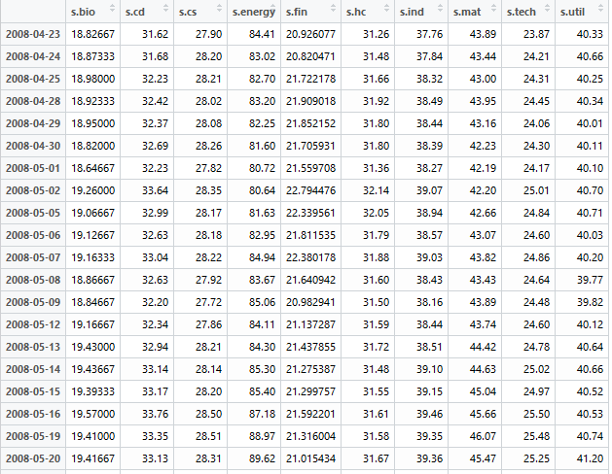
Data
Biotech
Consumer Discretionary
Consumer Staples
Energy
Healthcare
Industrials
Technology
Utilities
Materials
Real Estate
Financials

Slide 4
Methodology:
Create pairs for trading by analyzing correlations between ETFs
Market price data
Market daily return data
Time series ARMA(p,q,d) modelled residuals
Time series ARMA + GARCH modelled residuals
Test pairs profitability through a pairs trading backtest function
Optimize all backtests for signal line and stop loss thresholds
Construct Portfolio Strategies to test our research in a real world application

Slide 5
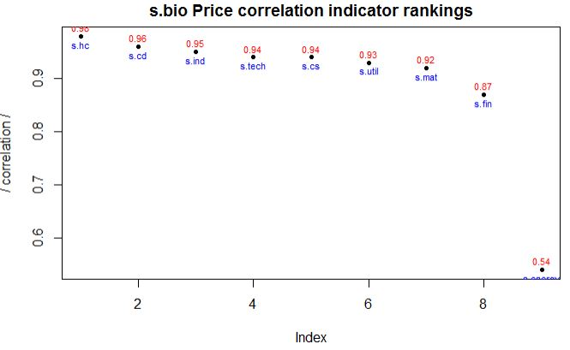
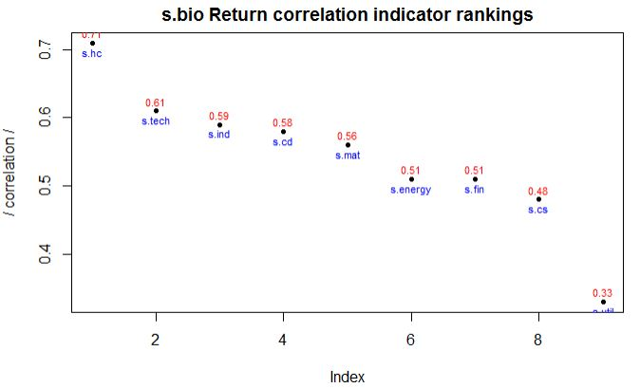
Analyzing Prices and Returns to find Correlations
Correlation are ranked by absolute value and plotted for detailed analysis
We select the most highly correlated ETF to each of the 10 ETFs for trading analysis
s.hc = 0.98
s.cd = 0.96
s.hc = 0.71
Most ETFs show similar correlation ranks across both prices and returns
The returns are important because the time series models will be built from the returns

Slide 6
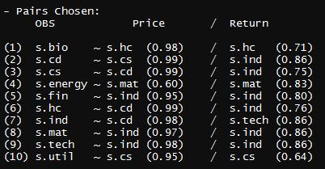
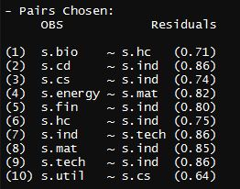
Resulting Pairs (Top Correlation Only)
Market Price and Return
ARMA model Residuals
Correlations decrease for Returns and Residuals
Return and Residual Correlations show little difference
We need to test all ETFs exhibiting very high correlation to the target ETF to identify the best pair properly

Slide 7
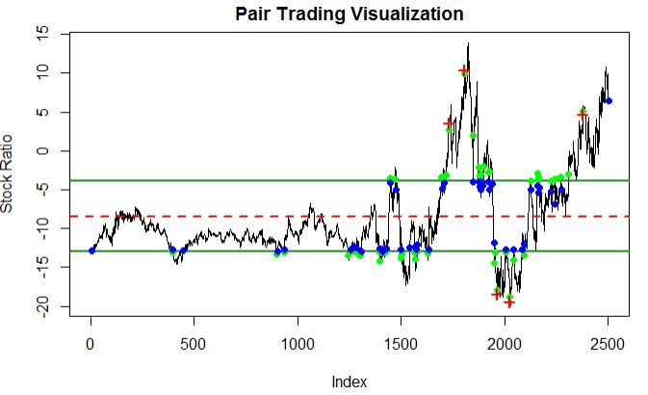
Pairs Trading Backtest – Price Example (s.bio)
‘k’ = 0.8
‘s’ = -0.05

Slide 8
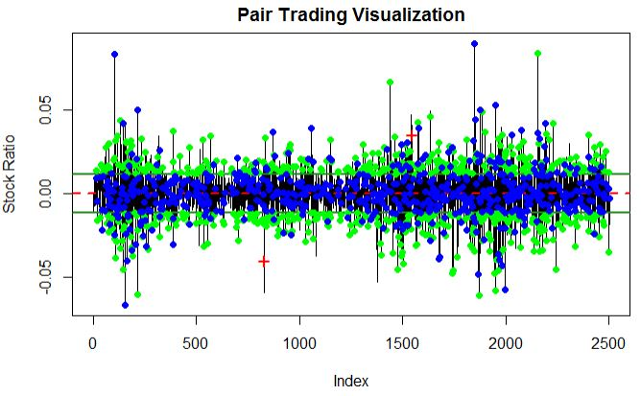

Pairs Trading Backtest – Return Example (s.bio)
‘k’ = 0.8
‘s’ = -0.05

Slide 9
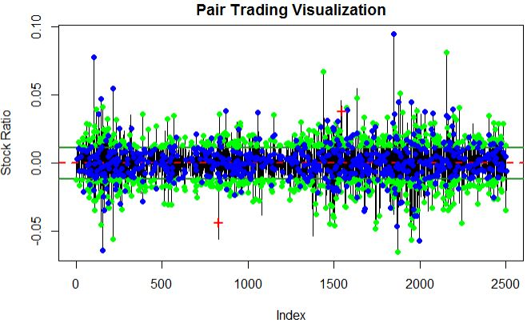

Pairs Trading Backtest – Residuals Example (s.bio)
‘k’ = 0.8
‘s’ = -0.05

Slide 10


Optimizing the Backtests
Optimization Matrix to maximize return percentage (%)
Optimize ‘k’ standard deviations from the mean of the distance series
Optimize ‘s’ stop loss percentage threshold

Slide 11
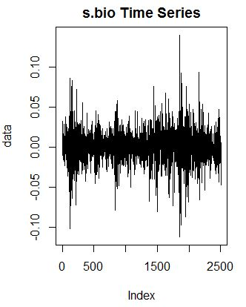
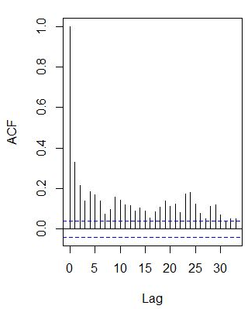
Analyzing ARMA modelled Residuals for correlations
All modelled time series show clear correlation in their squared residuals
They also show possible signs of GARCH effects in the time series data itself
Modeling the Volatility is required
Squared Residuals ACF

Slide 12
Next Steps
Modelling the Time Series Data for Volatility Effects:
Apply ARCH/GARCH models until the squared residuals resemble white noise
Compare Performance of Backtests:
For each type of correlation
Analyze changes in correlated pairs and performance
Construct Portfolio Backtests
Real World Application Testing
Performance against the broad market
Performance against holding all ETFs long

Slide 13
Time Series Modelling effects on Pairs Trading Profitability among US Sector SPDR ETFs
YUANYUAN LIU
WYATT MARCINIAK
JIMIT SANGHVI
MUYE ZHANG

